Slide 1
HC Starck, Inc.
Lead Time Reduction

Slide 2
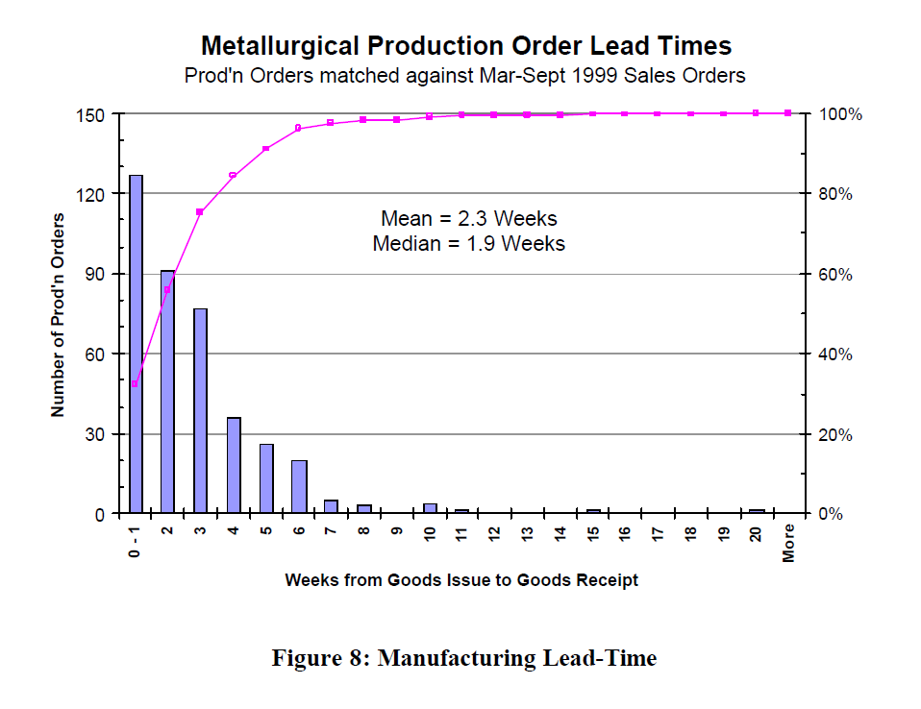
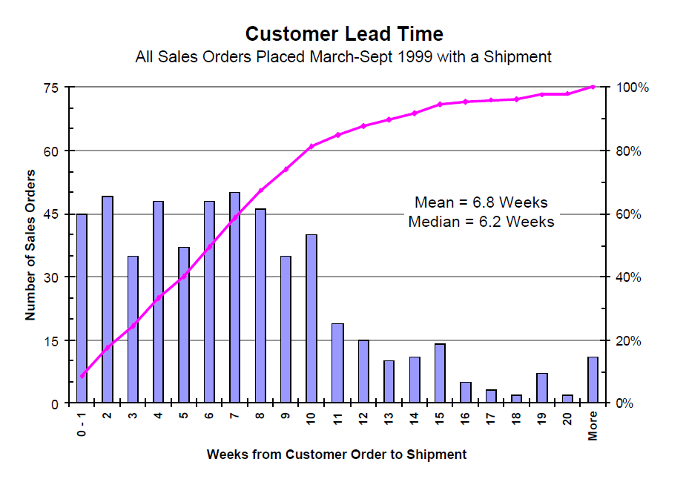
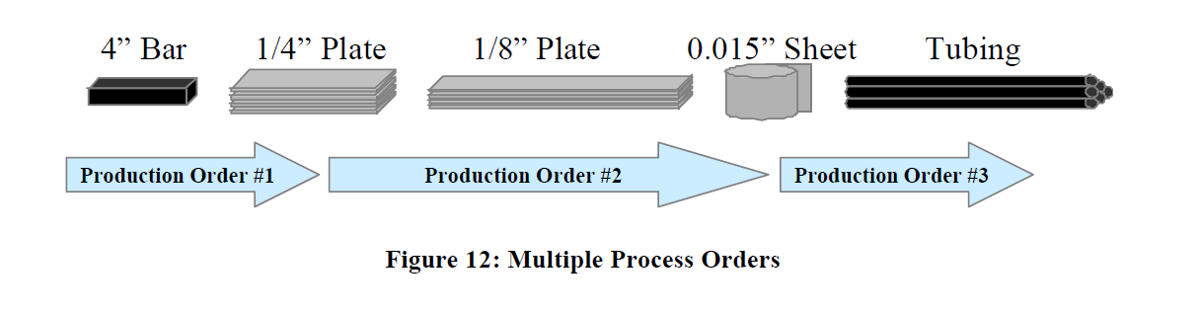

Slide 3
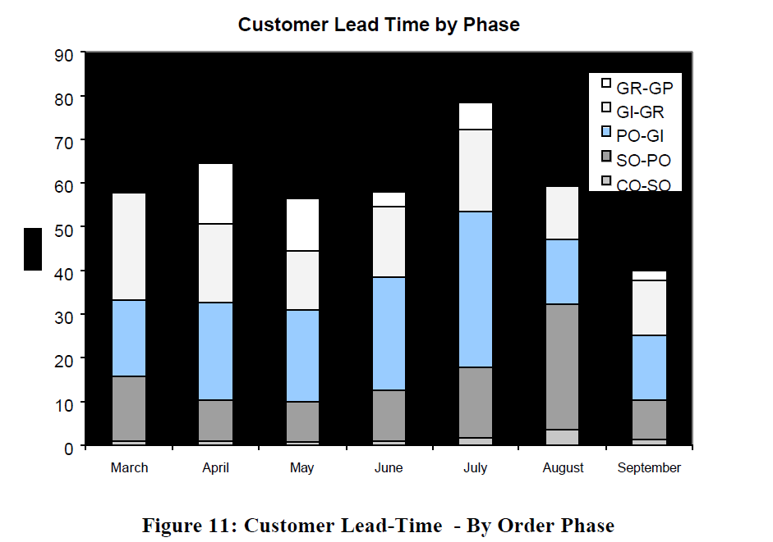

Slide 4
Why are the lead times so long?
Production planning and scheduling was being done manually without using the SAP system. Production orders did not move through the system continuously and usually got stacked at the production supervisor's desk till the deadlines drew nearer.
A make-to-order policy was being followed. Daily meetings to ensure no orders get delayed resulted in the policy changing to an 'expedite late orders' policy.
Production orders were being executed sequentially, meaning the next order could not begin before the completion of the previous one. This was the largest contributor to the long lead time.

Slide 5
How might Starck reduce or affect the lead times?
Fix the algorithms in the SAP R/3 system and employ its complete usage.
Maintain some standard stock of the common intermediate products to reduce the time spent in sequential production order processing
Despite the wide range of products they offer, only a handful seem to experience regular demand. For these products, using a make-to-stock policy might improve lead times greatly. We did an ABC analysis on the demands of the alloy 1 and 2 products to find which ones should be made-to-stock.

Slide 6
What are the costs of reducing the lead times? What are the benefits of reducing the lead times?
Inventory costs from executing the make-to-stock policy and stocking up on intermediate products. Labor and operating costs from changing the current production schedule.
Reducing lead times will aid with customer retention and satisfaction and increase sales capacity.

Slide 7
Policies to reduce lead times

Slide 8
Policy 1
Even though there are so many products, only a few products are ordered regularly
We do an ABC classification on the products based on order quantity
We follow a make-to-stock policy for A category products and make-to-order policy for other products
For Alloy 1, 8 out of 60 products to convert to make-to-stock
For Alloy 2, 6 out of 55 products to convert to make-to-stock

Slide 9
Alloy 1
Gauge | Description | Total | Mean | Std | CV | % | Cumulative % | ABC
0.002 | Foil | 8866 | 985.11 | 350.78 | 0.36 | 21.88 | 21.88 | A
0.015 | Sheet | 5931 | 659.00 | 559.82 | 0.85 | 14.64 | 36.52 | A
0.005 | Sheet | 5661 | 629.00 | 221.75 | 0.35 | 13.97 | 50.50 | A
0.5 | Disk - 10" dia | 3170 | 352.22 | 317.60 | 0.90 | 7.82 | 58.32 | A
0.03 | Sheet | 2902 | 322.44 | 211.32 | 0.66 | 7.16 | 65.49 | A
0.04 | Sheet | 2334 | 259.33 | 201.81 | 0.78 | 5.76 | 71.25 | A
0.01 | Sheet | 1766 | 196.22 | 158.09 | 0.81 | 4.36 | 75.61 | A
0.25 | Plate | 1714 | 190.44 | 309.56 | 1.63 | 4.23 | 79.84 | A
0.06 | Plate | 1636 | 181.78 | 183.00 | 1.01 | 4.04 | 83.87
0.125 | Plate | 1265 | 140.56 | 174.12 | 1.24 | 3.12 | 87.00

Slide 10
Alloy 2
Gauge | Description | Total | Mean | STD | CV | % | Cumulative % | ABC
0.015 | Welded Tube .75" OD | 11,622.92 | 1,291.44 | 848.23 | 0.66 | 26.35 | 26.35 | A
0.02 | Sheet Annealed | 8,680.54 | 964.50 | 1,116.19 | 1.16 | 19.68 | 46.04 | A
0.03 | Sheet Annealed | 7,519.68 | 835.52 | 502.68 | 0.60 | 17.05 | 63.09 | A
0.02 | Welded Tube .75" OD | 4,996.42 | 555.16 | 916.85 | 1.65 | 11.33 | 74.42 | A
0.015 | Welded Tube 1.0" OD | 1,461.71 | 162.41 | 190.78 | 1.17 | 3.31 | 77.73 | A
0.06 | Plate Annealed | 1,381.81 | 153.53 | 172.83 | 1.13 | 3.13 | 80.87 | A
0.015 | Welded Tube 1" OD With Cap | 1,179.37 | 131.04 | 313.26 | 2.39 | 2.67 | 83.54
0.045 | Sheet Annealed | 1,132.57 | 125.84 | 153.87 | 1.22 | 2.57 | 86.11

Slide 11
Policy 2
We group products together based on their gauge
Products in same group will have same intermediate products in some stages
We do an ABC classification on these groups
We maintain some standard stock for intermediate products of the products in A category

Slide 12
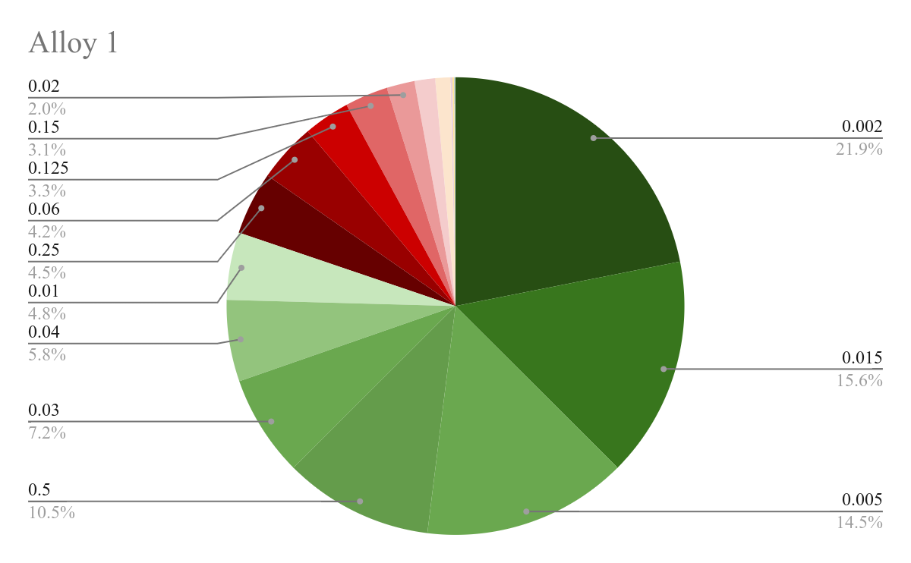
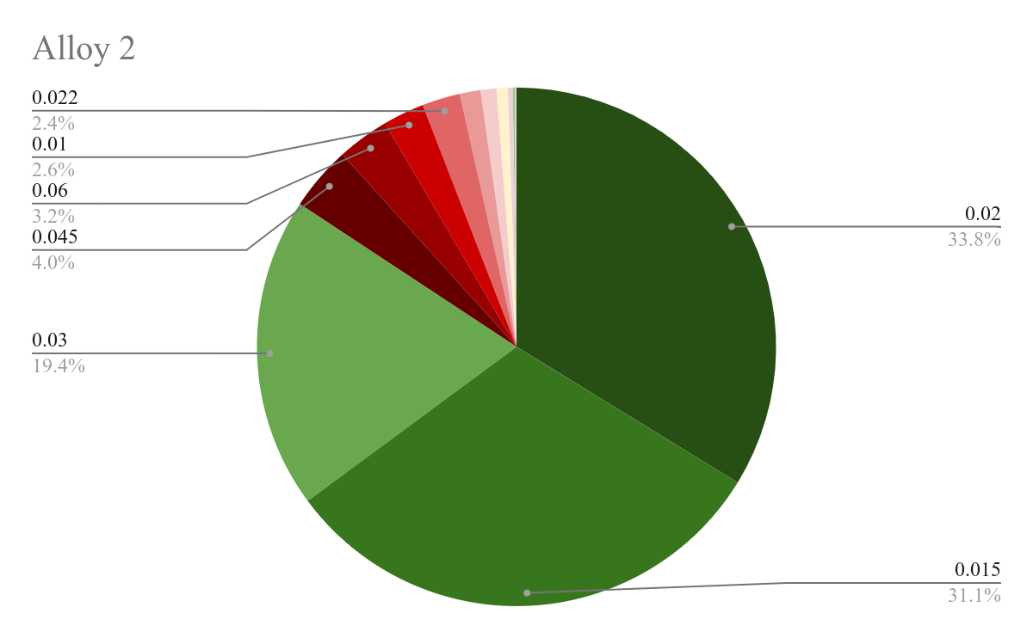

Slide 13
Policy 3
This is a hybrid of Policy 1 and Policy 2
We first do the ABC classification used in Policy 1 and follow make-to-stock policy for A category products
For rest of the products, we follow policy 2 i.e stock up on the intermediate products based on the gauge

Slide 14
Alloy 1
Gauge | Sum of Total | % | Cumulative % | ABC
0.06 | 1690 | 20.6879667 | 20.6879667 | B
0.125 | 1321 | 16.17088995 | 36.85885665 | B
0.15 | 1236 | 15.13037091 | 51.98922757 | B
0.5 | 1101 | 13.47778186 | 65.46700943 | B
0.02 | 800 | 9.793120333 | 75.26012976 | B
0.75 | 590 | 7.222426246 | 82.482556 | B
0.375 | 432 | 5.28828498 | 87.77084098
0.015 | 386 | 4.725180561 | 92.49602154

Slide 15
Alloy 2
Gauge | Sum of Total | % | Cumulative % | ABC
0.045 | 1720 | 20.3815618 | 20.3815618 | B
0.015 | 1594 | 18.8884939 | 39.27005569 | B
0.01 | 1098 | 13.01102026 | 52.28107596 | B
0.022 | 1014 | 12.01564166 | 64.29671762 | B
0.03 | 769 | 9.112454082 | 73.4091717 | B
0.02 | 744 | 8.816210451 | 82.22538215 | B
0.002 | 551 | 6.529209622 | 88.75459178
0.11 | 418 | 4.953193506 | 93.70778528

